Slide 1

MAINTAIN FINANCIAL STANDARDS AND RECORDS
D1.HFI.CL8.02
D1.HFA.CL7.03
Notes:
Trainer and trainees to introduce themselves.

Slide 2
Introduction
Maintain financial standards and records:
Classroom schedule
Trainer contact details
Assessments
Resources:
Calculator, pen and paper
Notes:
Session Introduction
Welcome trainees and introduce the classroom schedule
Discuss housekeeping issues such as times of attendance, expected classroom behavior, contact details, resources required such as a calculator
Explain that the trainees will be assessed and the requirements of those assessments.
Trainers will find it beneficial to have access to the following training equipment:
Whiteboard
Butchers paper
Spreadsheet software is optional but may assist in the demonstration of calculations
Internet access is optional but will assist with using relevant, local examples to illustrate concepts.
Get to know you activity on next slide.

Slide 3

Introduction
Getting to know each other:
What is your name?
Where do you live?
Why are you doing this course?
Where do you work?
Have you studied a module or unit similar to this before?
Notes:
Ice-breaker (10 minutes)
If the trainees haven’t met before ask them to break into pairs. Each person in the pair should introduce himself to the other and ask key questions as above.
After the trainees have had some time to talk, ask them to introduce their partner using the information they have learnt about them.
If the trainees have met you may prefer to ask them to introduce themselves to you, the trainer, using the questions above as a basis for discussion.
The trainer will now have a better idea of the composition of the group and the group will feel more comfortable with each other. It is sometimes helpful to make a brief note next to the trainee’s name regarding their experience or knowledge as you may be able to draw on this throughout the module.

Slide 4

Introduction
Unit comprises two elements which are covered in this sequence:
Implement and monitor financial systems:
Internal control system
Maintain financial systems:
Check and balance transactions
Provide financial information:
Routine reports
Notes:
Trainers please note that the sequence of materials in the slides is different to the training manual. The slides begin with an overview of the system, the controls the system needs and then the various procedures and processes to maintain the integrity of the system. Finally, examples of the products of the system, the financial reports are discussed.

Slide 5

Implement and monitor the financial system
A Definition of Accounting “The systematic recording, reporting and analysis of financial transactions of a business”
The Accounting System The people and the processes by which an organisation records, reports and analyses financial transactions
Notes:
Trainer: Before we begin there are some concepts to explain first.
To assist trainees to contextualise the definition of accounting, ask them for examples of financial transactions in their day to day lives. Your objective is to illustrate that this is any transaction where goods or services are exchanged for payment. You may like to begin with some examples of your own such as:
Purchases of goods and services
Use of their mobile phones
Payment of wages for work performed
Payment of tuition fees for this course.
The terms financial and accounting system are used throughout this unit to explain the process of recording transactions. In the strictest sense, the financial system encompasses more than just the accounting system but for the purposes of this unit, the terms are used interchangeably.

Slide 6

Implement and monitor the financial system
Why have an accounting system?
Manager’s responsibilities:
Planning
Organising
Directing
Controlling
Financial management
Manual and computerised systems
Notes:
Trainers: Explain the key responsibilities of managers and the support the financial or accounting system can provide. It may be possible to illustrate through practical examples from personal or trainee’s experience. It is necessary that adequate time is taken to do this as this discussion will highlight the purpose and importance of financial information.
Trainers also need to explain that although may organisations use computerised systems, this unit will explain a manual system as all computerised accounting systems are based on manual processes and procedures.

Slide 7
Maintaining the financial system
TRANSACTIONS
SOURCE DOCUMENTS
JOURNALS
LEDGERS
TRIAL BALANCE
FINANCIAL REPORTS
Inputs
Processing
Outputs
Notes:
Trainers are now introducing trainees to the flow of financial transactions and how an accounting system is structured so that financial transactions are ultimately summarised and reported. This is discussed in terms of illustrating inputs, outputs and processing as this is the manner in which the system is discussed throughout the manual.
The design of the accounting or financial system is continued on the next slide

Slide 8

Implement and monitor the financial system
The accounting system:
Analysis
Design
Implementation and review
Notes:
Trainers work through the process for developing an accounting system with trainees. The exercise o the next slide can be completed first, if the trainees have been asked to read the training manual or trainers can explain concepts and then trainees work through the exercise. This should be completed in small groups.

Slide 9

Implement and monitor the financial system
The accounting system:
Key considerations:
Costs and benefits
Compatibility
Flexibility
Internal control – discussed in detail
Activity
Discuss in small groups the sources and information requirements a hospitality and tourism business might have from its accounting system.
Notes:
Trainers note that Internal control considerations are discussed in detail over the next series of slides so discussion for the activity should merely focus on information requirements.

Slide 10

Implement internal controls
Defined
Measures:
Safeguard assets
Promote efficient operations
Maintain accurate and reliable accounting records
Compliance with policies and procedures
Notes:
Trainers: The internal control system encompasses and protects the accounting system. It is important that trainees are clear on the need for internal controls and can identify internal control measures in the workplace. The next series of slides includes activities that should illustrate this. Refer to the training manual to ensure all internal control measures are discussed.

Slide 11

Implement internal controls
Structure of the system:
Administrative controls:
Organisation chart
Activity
Financial controls – focus for unit:
Safeguard assets
Notes:
Trainer: The training manual includes two organisational charts. Trainees use these examples to create an organisational chart for their workplace or a local example provided by the trainer. This activity can be completed individually or in small groups. The purpose is to highlight that the organisation chart defines responsibilities and supervision in an organisation.
Financial controls are continued on the next number of slides.

Slide 12
Implement internal controls
Structure of the system:
Financial controls – focus for unit:
Complete
Valid
Accurate
Adequate safeguards
Accountability
Notes:
Trainers: Financial controls address these objectives for financial or accounting information. They shape the reasons or purpose behind many of the internal control processes and procedures. Trainees should be reminded to keep these objectives in mind. It can help to display them on a piece of butcher’s paper or whiteboard when discussing internal controls.

Slide 13

Implement internal controls
Principles of internal control:
Clear lines of responsibility:
Duties
Supervision
Separation of duties for related transactions:
Examples of related transactions
Notes:
Trainer: Trainees to appreciate that when employees understand the reasons for internal controls as well as the principles, they are more likely to follow the processes and procedures to maintain an effective system. You may choose to start with the activity on slide 16 and illustrate the principles or introduce all the principles to trainees first.

Slide 14

Implement internal controls
Principles of internal control:
Written and documentation procedures
Set standards and evaluate results
Mechanical and electronic devices
Internal audits
Limitations of systems
Notes:
Continued from the previous slide

Slide 15

Implement internal controls
Challenges for hospitality and tourism industry:
Business size
Cash transactions
Labour intensive
Inventory
Sales cycles
E-commerce
Notes:
Continued from the previous slide

Slide 16
Implement internal controls
Activities
Identify and describe the internal control issue:
The manager of a food and beverage outlet is responsible for purchasing beverage stocks, authorising payment for stock ordered and counting beverage inventory.
The manager of a souvenir shop at an accommodation venue records the cash takings, deposits the takings into the bank account and checks that the accounting system and the bank account are the same at the end of a month.
The room amenities supply cupboard can be accessed by all housekeeping staff at an accommodation venue.
Notes:
Continued from the previous slide

Slide 17
Implement internal controls
Accounts Receivable
Fixed Assets
Accounts Payable
General Ledger
Other
Payroll
Integrated Financial System
Notes:
Trainer: the activity has highlighted internal control issues in certain functional areas in an establishment. Internal control processes and procedures are discussed over the next slides in terms of each area of a financial system

Slide 18

Implement internal controls
Internal controls and cash:
Discussion from previous activity
The bank account
Cash receipts:
Separation of related transactions
Documentation
Notes:
Trainees must understand that the definition of cash includes all local legal forms of payment. The earlier activity would have prompted discussions surrounding internal controls for cash and this slide and the next expand that discussion.

Slide 19

Implement internal controls
Internal controls and cash:
Cash payments:
Authorisation and supervision
Separation of related transactions
Documentation
Petty cash
Cash budgets
Notes:
Continued from previous slide

Slide 20

Implement internal controls
Activity
In small groups, document the internal control procedures for cash that are important for a hospitality and tourism establishment. You can choose the size of the business as well as the products sold but you must specify this to the group.
Notes:
Trainer: Trainees can refer to the training manual for details and must cover controls for cash receipts and payments, petty cash and discuss cash budgets

Slide 21

Implement internal controls
Internal controls and accounts receivable:
Managing credit policies
Adjustments to account balances:
Authorisation
Documentation
Cash received:
Separation of related transactions
Final balances:
Responsibilities
Notes:
Trainer: Explain the nature of accounts receivable in the hospitality and tourism industry and that credit may not always be extended to customers, guests or clients. Compare a small restaurant to a large accommodation venue to illustrate for example.

Slide 22
Implement internal controls
Activity
Document a set of procedures that addresses the separation of responsibilities for accounts receivable tasks. Specify the personnel that would conduct the tasks.
Notes:
Trainer: Trainees can refer to the training manual for details and must cover controls for cash receipts, adjustments and the reconciliation of final balances

Slide 23
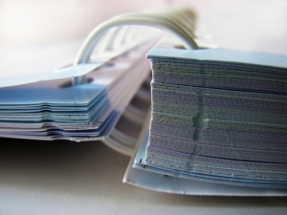
Implement internal controls
Internal controls and purchases:
Separation of responsibilities:
Requests
Orders
Receiving goods
Recording in the accounting system
Documentation:
Standard, numbered
Notes:
Trainer: Purchases refers to the purchase of supplies that are converted to goods and services for re-sale. An activity follows on the next slide.

Slide 24
Implement internal controls
Activity
Discuss the personnel that may be needed to implement effective controls over purchasing. Which responsibilities could be combined, if any, in a smaller organisation? Is there additional procedures that could be put in place if this was the case?
Notes:
Continued from previous slide

Slide 25

Implement internal controls
Internal controls and payroll:
Confidentiality
Bank account
Employee details
Processing payroll:
Authorisation
Distributing payroll
Notes:
Trainers to ensure that trainees appreciate the need for confidentiality surrounding the payroll process. An activity follows.

Slide 26
Implement internal controls
Activity
Describe the key internal control principles that the processed and procedures in the payroll function address.
Notes:
Continued from previous slide

Slide 27

Implement internal controls
Internal controls and inventory:
Discussion from activity – room amenities
Physical count
Secure storage
Access
Recording system
Managing quantities ordered
Notes:
Trainer: Not all hospitality and tourism establishments hold significant levels of inventory. Internal controls should be appropriate to the quantities and value of the stock held. Trainees can provide examples where possible. With regard to quantities ordered, trainees do not need to know the inventory recording systems but that as inventory is received and used it needs to be recorded appropriately.

Slide 28

Implement internal controls
Other internal controls:
Fixed assets
Standard costs:
Purpose
Nature
Type
Minimising not eliminating risks!!
Notes:
Trainer: Refer to the training manual for details on the other internal controls trainees should know. Standard costs can be discussed by asking trainees to provide examples of aspects of a business that this internal control may be used. This can be a class activity if appropriate.
Remember that internal controls do not eliminate risks but seek to minimise them.

Slide 29
Monitoring the financial system
Monitoring the accounting system:
Why?
How?
Internal audits
Analysis
Asset values
Notes:
Trainer: When internal controls are implemented, managers need to monitor the accounting system to ensure the objectives of reliability, validity, completeness and accuracy are met. This slide provides an overview for the next series of slides.

Slide 30

Monitoring the financial system
Internal audit process:
Meeting
Identify internal controls
Evaluate internal controls
Assess outcome
Final report
Notes:
Trainers highlight the variations to internal audits depending on the size of the organisation and should refer to personal or trainees experience if possible.

Slide 31
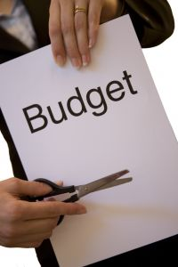
Monitoring the financial system
Monitoring the financial system:
Effective and efficient operations
Budgets
Reports
Activity
Match the operational information the budgets and associated reports monitor.
Notes:
Trainer: Provide trainees with a range of budget names, the training manual can be used as a guide for trainees to discuss the information the budget contains. Trainees can match the budget to the report, also from the training manual.

Slide 32
Monitoring the financial system
Variance analysis:
Defined
Favourable and unfavourable
 | Actual over budget | Actual under budget
Sales and profit | Improve profit Favourable | Reduce profit Unfavourable
Expenses | Reduce profit Unfavourable | Improve profit Favourable
Notes:
Trainer: It is important that trainees do not think of variances as good or bad but favourable and unfavourable compared to budget.

Slide 33

Monitoring the financial system
Variance analysis:
Five steps:
Compare actual and budget results
Identify significant variances
Determine reason for variance
Take necessary corrective action
Report
Notes:
Continued from previous slide

Slide 34

Monitoring the financial system
Variance analysis:
Determine reason for variance:
Price and volume
Cost and quantity
Watch for counter-balances
Corrective action:
Internal controls
Notes:
Continued from previous slide

Slide 35
Monitoring the financial system
Horizontal analysis:
Actual results and budgeted numbers for EACH line item in financial data is compared
Actual results and budgeted numbers for EACH line item in financial data is compared
Actual minus budget = Variance in monetary unit
Line item | Budget | Actual | Variance | Favourable Unfavourable
Sales | 56,000 | 58,200 | 2,200 | Favourable
Wages | 16,800 | 18,900 | 2,100 | Unfavourable
Notes:
Trainers take trainees through calculations. Note that trainers should source local, relevant examples for exercises for trainees to practice all variance calculations.

Slide 36
Monitoring the financial system
Variance analysis:
Reasons:
Actual: 4,100 hours @ $7.80 per hour = $31,980
Budget: 4,350 hours @ $7.50 per hour = $32,625
Variance (favourable) $645
Housekeeping payroll expense
Actual | Budget | Difference | F or U?
$31,980 | $32,625 | $645 | Favourable
Notes:
Continued from previous slide

Slide 37
Monitoring the financial system
Variance analysis:
Labour/Payroll Rate Variance:
4,100 hours x $0.30 = $1,230 Unfavourable
Labour/Payroll Efficiency Variance:
250 hours x $7.50 = $1,875 Favourable
Total Variance = $645 Favourable
Notes:
Continued from previous slide - this highlights the two reasons why there may be a payroll variance – the hours worked or the rates of pay.

Slide 38
Monitoring the financial system
Vertical analysis:
EACH line item calculated as a percentage of sales
Line item divided by sales x 100 = Variance
Budget and actual reports are calculated separately
Line item | Budget | Variance | Actual | Variance
Sales | 56,000 | 100% | 58,200 | 100%
Wages | 16,800 | 30.0% | 18,900 | 32.47%
Rent | 11,000 | 19.64% | 11,000 | 18.9%
Advertising | 560 | 1.0% | 800 | 1.37%
Total Expenses | 28,360 | 50.64% | 30,700 | 52.75%
Profit or Income | 27,640 | 49.36% | 25,300 | 43.47%
Notes:
Trainers take trainees through calculations noting that budget line items are divided by budgeted sales and actual line items by actual sales.

Slide 39

Monitoring the financial system
Ratio analysis:
Defined
Financial
Operational
Notes:
Trainers: ensure that trainees are aware of the different ways ratios are expressed and that the ratio must have meaning. An explanation as follows might be of assistance:
What is a ratio?
It shows the relative size of two numbers, calculated by dividing one number by the other
For example, if a business has Assets of $500,000 and Liabilities of $350,000, Liabilities divided by Assets shows a ratio of 0.7 to 1
For each $1 of Assets, the business has Liabilities of $0.70
Or if Assets are divided by Liabilities, a ratio of 1.429 results
For each $1 owed to outsiders, the business has $1.43 in Assets
The distinction between operational and financial ratios for hospitality and tourism establishments can be highlighted by referring to the ratios in the training manual

Slide 40

Monitoring the financial system
Ratio analysis:
Key financial ratios:
Gross and net profit margins
Liquidity
Accounts receivable turnover
Inventory turnover
Notes:
Trainer: at a minimum, trainees should be able to calculate and interpret the ratios listed.

Slide 41

Monitoring the financial system
Ratio analysis:
Key operational ratios:
Occupancy
RevPAR
Food and beverage cost percentages
Payroll cost percentage
Notes:
Trainer: at a minimum, trainees should be able to calculate and interpret the ratios listed

Slide 42

Monitoring the financial system
Ratio analysis:
Worked example from financial statements
Additional exercise on next slide
Notes:
Trainers to source local financial statements and operational data to work through the key ratios and their interpretations with trainees. Formulas and interpretation notes are included in the training manual

Slide 43
Monitoring the financial system
Ratio analysis:
The following financial information highlights the profitability and financial stability in the last 3 years of a small restaurant.
Required:
Using the above information, answer each of the following questions, including an explanation of why you answered each question this way:
On average, is the restaurant extending a shorter or longer credit period to its customer?
Over the years has more or less money been invested in food inventory?
During the period, has the liquidity of the restaurant improved?
Imagine that in 20 x 3 the restaurant wants to finance a proposed expansion through a loan. Relative to its financial position in 20 x 1, do you think it will be easier or harder to borrow?
Year | 20 x 1 | 20 x 2 | 20 x 3
Current asset ratio | 1.20 | 1.34 | 1.46
Food inventory turnover | 36 times | 30 times | 25 times
Accounts receivable turnover | 29 times | 25 times | 19 times
Debt to equity | 2.40 | 2.20 | 1.85
Sales (all on credit) | 945,000 | 952,000 | 948,000
Notes:
Continued from previous slides

Slide 44

Monitoring the financial system
Benchmarking:
Benchmarks:
Defined
Common examples
Activity
Notes:
Trainers – source local benchmarks and compare to ratios calculated from the financial statements. Trainees should work in groups to enable discussion and enhance understanding.

Slide 45
Monitoring the financial system
Trend analysis:
Defined
Horizontal analysis:
Base period
Vertical analysis:
Base account category – Revenue
Notes:
Trainers explain how trends help managers to improve their understanding of operations. An example follows to aid discussions.

Slide 46
Monitoring the financial system
Common size | 2010 | 2011 | 2012
 |  | change | change
Sales | 100.0% | 100.0% | 100.0%
Cost of Sales | 48.1% | 75.0% | 80.0%
Gross profit | 51.9% | 25.0% | 20.0%
Selling expenses | 10.4% | 7.5% | 6.0%
Administration expenses | 19.3% | 25.0% | 30.0%
Financial expenses | 8.1% | 0.0% | 0.0%
Total expenses | 37.8% | 32.5% | 36.0%
Net Profit | 14.1% | -7.5% | -16.0%
Notes:
Continued from previous slide

Slide 47

Monitoring the financial system
Monitoring cash:
Cash budget:
Actual and budget cash flows
Opening and closing bank balances
Example on next slide
CP3 system:
purchase orders
Notes:
Trainees work through cash budget on next slide, explaining source of information. Relevant, local examples can also be used as activities as appropriate.

Slide 48
Monitoring the financial system
Monitoring cash – Cash budget
The Mid Semester Conference Cash Budget for the period April – June
 | APRIL | MAY | JUNE | TOTAL
Cash Inflows Registration Sales Accommodation Sales | 30,000 5,000 | 25,000 10,000 | 45,000 17,500 | 100,000 32,000
TOTAL | 35,000 | 35,000 | 62,500 | 132,000
Cash Outflows Wages Rent Fixed Advertising Variable Advertising Light & Power Insurance Renovations | 14,000 3,000 2,000 2,000 | 12,250 3,000 2,000 1,750 | 24,500 3,000 2,000 3,500 2,500 4,500 | 50,750 9,000 6,000 7,250 2,50 4,500
TOTAL | 21,000 | 19,000 | 40,000 | 80,000
Net Cash Inflow | 14,000 | 16,000 | 22,500 | 52,500
Cash Balance Beginning | 6,500 | 20,500 | 36,500 | 6,500
Cash Balance End | 20,500 | 36,500 | 59,000 | 59,000
Notes:
Continued from previous slide

Slide 49

Monitoring the financial system
Monitoring accounts receivable:
Cash flows
Accounts receivable ageing schedule:
Timing
Amounts
Credit policies
Accounts receivable turnover ratio (revised)
Procedures review
Notes:
Trainers: highlight cash from accounts receivable as cash inflows and how that relates to budget from previous page. The accounts receivable ageing schedule and turnover ratio together provide the information for managers to monitor. Utilise the ration calculated earlier as an example for this discussion.

Slide 50

Monitoring the financial system
Monitoring inventory:
Stocktake or stock count:
Teams
Recording sheets
Input to accounting system
Collection procedures
Notes:
Trainers may wish to organise trainees into small groups to review the training manual and discuss how to monitor inventory to assist with decision making. The ratios calculated earlier can be used as examples for the exercise.

Slide 51

Monitoring the financial system
Monitoring inventory:
Inventory turnover ratio:
Calculation and formula (revised)
Cash flow implications
Notes:
Continued from previous slide

Slide 52

Monitoring the financial system
Monitoring fixed assets:
The fixed assets register:
Unique details
Values
Physical count
Notes:
Trainees to understand that it is both the physical presence of fixed assets and the value that management wish to monitor. Refer to the training manual using local examples to enhance discussion.

Slide 53
Maintaining the financial system
TRANSACTIONS
SOURCE DOCUMENTS
JOURNALS
LEDGERS
TRIAL BALANCE
FINANCIAL REPORTS
Inputs
JOURNALS
Processing
Outputs
Notes:
Trainer: The focus for the next series of slides is the input and processing phases in the accounting system

Slide 54

Checking transactions
What is a transaction?
External
Internal
Classifying transactions:
Assets
Liabilities
Owner’s equity
Revenue
Expenses
Notes:
Trainers: explain the difference between internal and external transactions using examples from the normal course of trainees experience. Definitions for the five account categories are found in the training manual.

Slide 55
Checking transactions
Classifying transactions:
Revenue – Expenses = Net Profit / (Loss)
The accounting equation:
Assets – Liabilities = Owner’s equity
Notes:
Trainer: Transactions are classified so that they can be reported appropriately. An exercise follows on the next slide

Slide 56
Checking transactions
Correctly identify the following items for the business:
Food sales Electricity usage
Advertising Insurance
Cash at bank Laundry
Rent Ticket sales
Room sales Vehicle repairs
Telephone usage Equipment
Accounts receivable Accounts payable
Fuel Tour sales
Inventory
Wages
Notes:
Trainer – this activity can be completed individually, in small groups or by the entire class led by the trainer. The next slide provides the solutions
Trainer may like to ask trainees to suggest items for themselves.

Slide 57
Checking transactions
Correctly identify the following as Revenue or Expense items for the business:
Food sales Revenue Electricity usage Expense
Advertising Expense Insurance Expense
Cash at Bank Asset Laundry Expense
Rent Expense Ticket Sales Revenue
Room Sales Revenue Vehicle repairs Expense
Telephone usage Expense Equipment Asset
Accounts receivable Asset Accounts payable Liability
Fuel Expense Tour Sales Revenue
Inventory Asset
Wages Expense
Notes:
Trainer: Solutions to the activity on the previous slide

Slide 58

Checking transactions
Identifying and valuing transactions:
Accounting principles and assumptions:
Accounting entity
Time period assumption
Going concern assumption
Monetary unit assumption
Cost principle
Accrual basis – next slide
Notes:
Trainees can form groups and provide their own explanations for each accounting principle and assumptions that are shared and used by the class.

Slide 59
Checking transactions
Identifying and valuing transactions:
Accrual basis:
Matching principle
Revenue recognition
Notes:
Continued from previous slide

Slide 60

Checking transactions
Recording transactions:
Three steps:
Analyse transactions for their effect on ledger accounts
Enter the transaction into a journal
Transfer the journal to a ledger account
Double entry
Notes:
Trainer: The diagram on the next slide explains the debit and credit rules and therefore illustrates double entry. Examples are provided in the training manual.

Slide 61
Checking transactions
Recording transactions:
Debits and credits
Account category | Normal balance | Transaction increases balance | Transaction decreases balance
Assets | DEBIT | DEBIT | CREDIT
Liabilities | CREDIT | CREDIT | DEBIT
Owner’s equity | CREDIT | CREDIT | DEBIT
Revenue | CREDIT | CREDIT | DEBIT
Expenses | DEBIT | DEBIT | CREDIT
Notes:
Trainer: Double entry is one of the key principles for entering transactions into the general ledger. Trainers must be sure to make clear to trainees that the words debit and credit have no meaning other than left and right and simply provide and instruction for entering an amount so that the overall account category balance either increases or decreases.

Slide 62
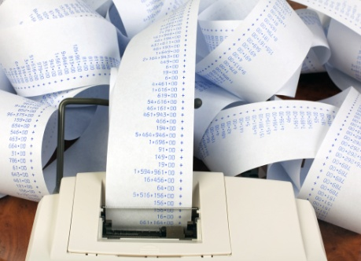
Checking transactions
Recording transactions:
Journals:
Book where all transactions are recorded
General journal
Special journals:
Cash receipts and cash payments
Sales and purchases
Notes:
Trainer: Journals are used in a manual accounting system to record the details of all transactions from source documents. A computerised system may not necessarily display journals in this manner. Examples of cash journals follow.

Slide 63
Checking transactions
Recording transactions:
CASH RECEIPTS JOURNAL
Cash sales | A/R | Capital | Furniture | Loans received | Sale of oven | Bank
37,110 | 20,990 | 10,000 | 575 | 11,500 | 1,725 | 81,900
CASH PAYMENT JOURNAL
Purchases | Wages | Rent | Advertising | A/P | Interest expense | Fitting & fixtures
14,545 | 15,290 | 2,820 | 1,425 | 12,485 | 900 | 1,570
Insurance expense | Loan repaid | Owner’s drawings | Purchase: new over | Bank
635 | 4,000 | 2,650 | 2,230 | 58,550
Notes:
Continued from previous slide

Slide 64

Checking transactions
Checking transactions:
Accuracy:
Source documents and journal details
Totals calculated correctly
Totals posted to the ledger
General journal
Completeness:
Cash receipts and cash payments
Sales and purchases
Notes:
Trainers refer to personal experience and experience from the trainees to describe the process of checking transactions for accuracy and completeness. Refer back to managers responsibilities with regard to accounting information and how this process fulfils that responsibility.

Slide 65

Checking transactions
Checking transactions:
Completeness
What does this mean?
Internal controls
Adjusting entries (more detail later!)
Notes:
Continued from previous slide

Slide 66
Balancing transactions
The Trial balance:
Debits = Credits
Format
Timing
Example company trial balance end of the month
Trial balance
Account name | Debit | Credit
Cash at bank | 24,800
Accounts receivable | 2,950
Prepaid rent | 3,000
Furniture | 16,500
Accounts payable |  | 13,100
Capital |  | 31,250
Drawings | 3,200
Revenue |  | 7,450
Salary expense | 950
Electricity & gas | 400
 | 51,800 | 51,800
Notes:
Trainer: Provide the trial balance that was used to create the financial statements that were analysed earlier if possible otherwise source a relevant, local example.

Slide 67

Balancing transactions
The trial balance:
Correcting errors:
Debits = Credits
Posting errors
Missing transactions
Checklist activity
Notes:
Continued from previous slide. Trainees to write up a checklist for preparing an accurate trial balance.

Slide 68

Balancing transactions
Adjusting entries:
What are they?
Alternative terms:
Balance day adjustments
Accruals and prepayments
Timing
Notes:
Trainer: Each of the adjusting entries that are common to hospitality and tourism organisations will be reviewed in the next series of slides. Details are provided in the training manual

Slide 69
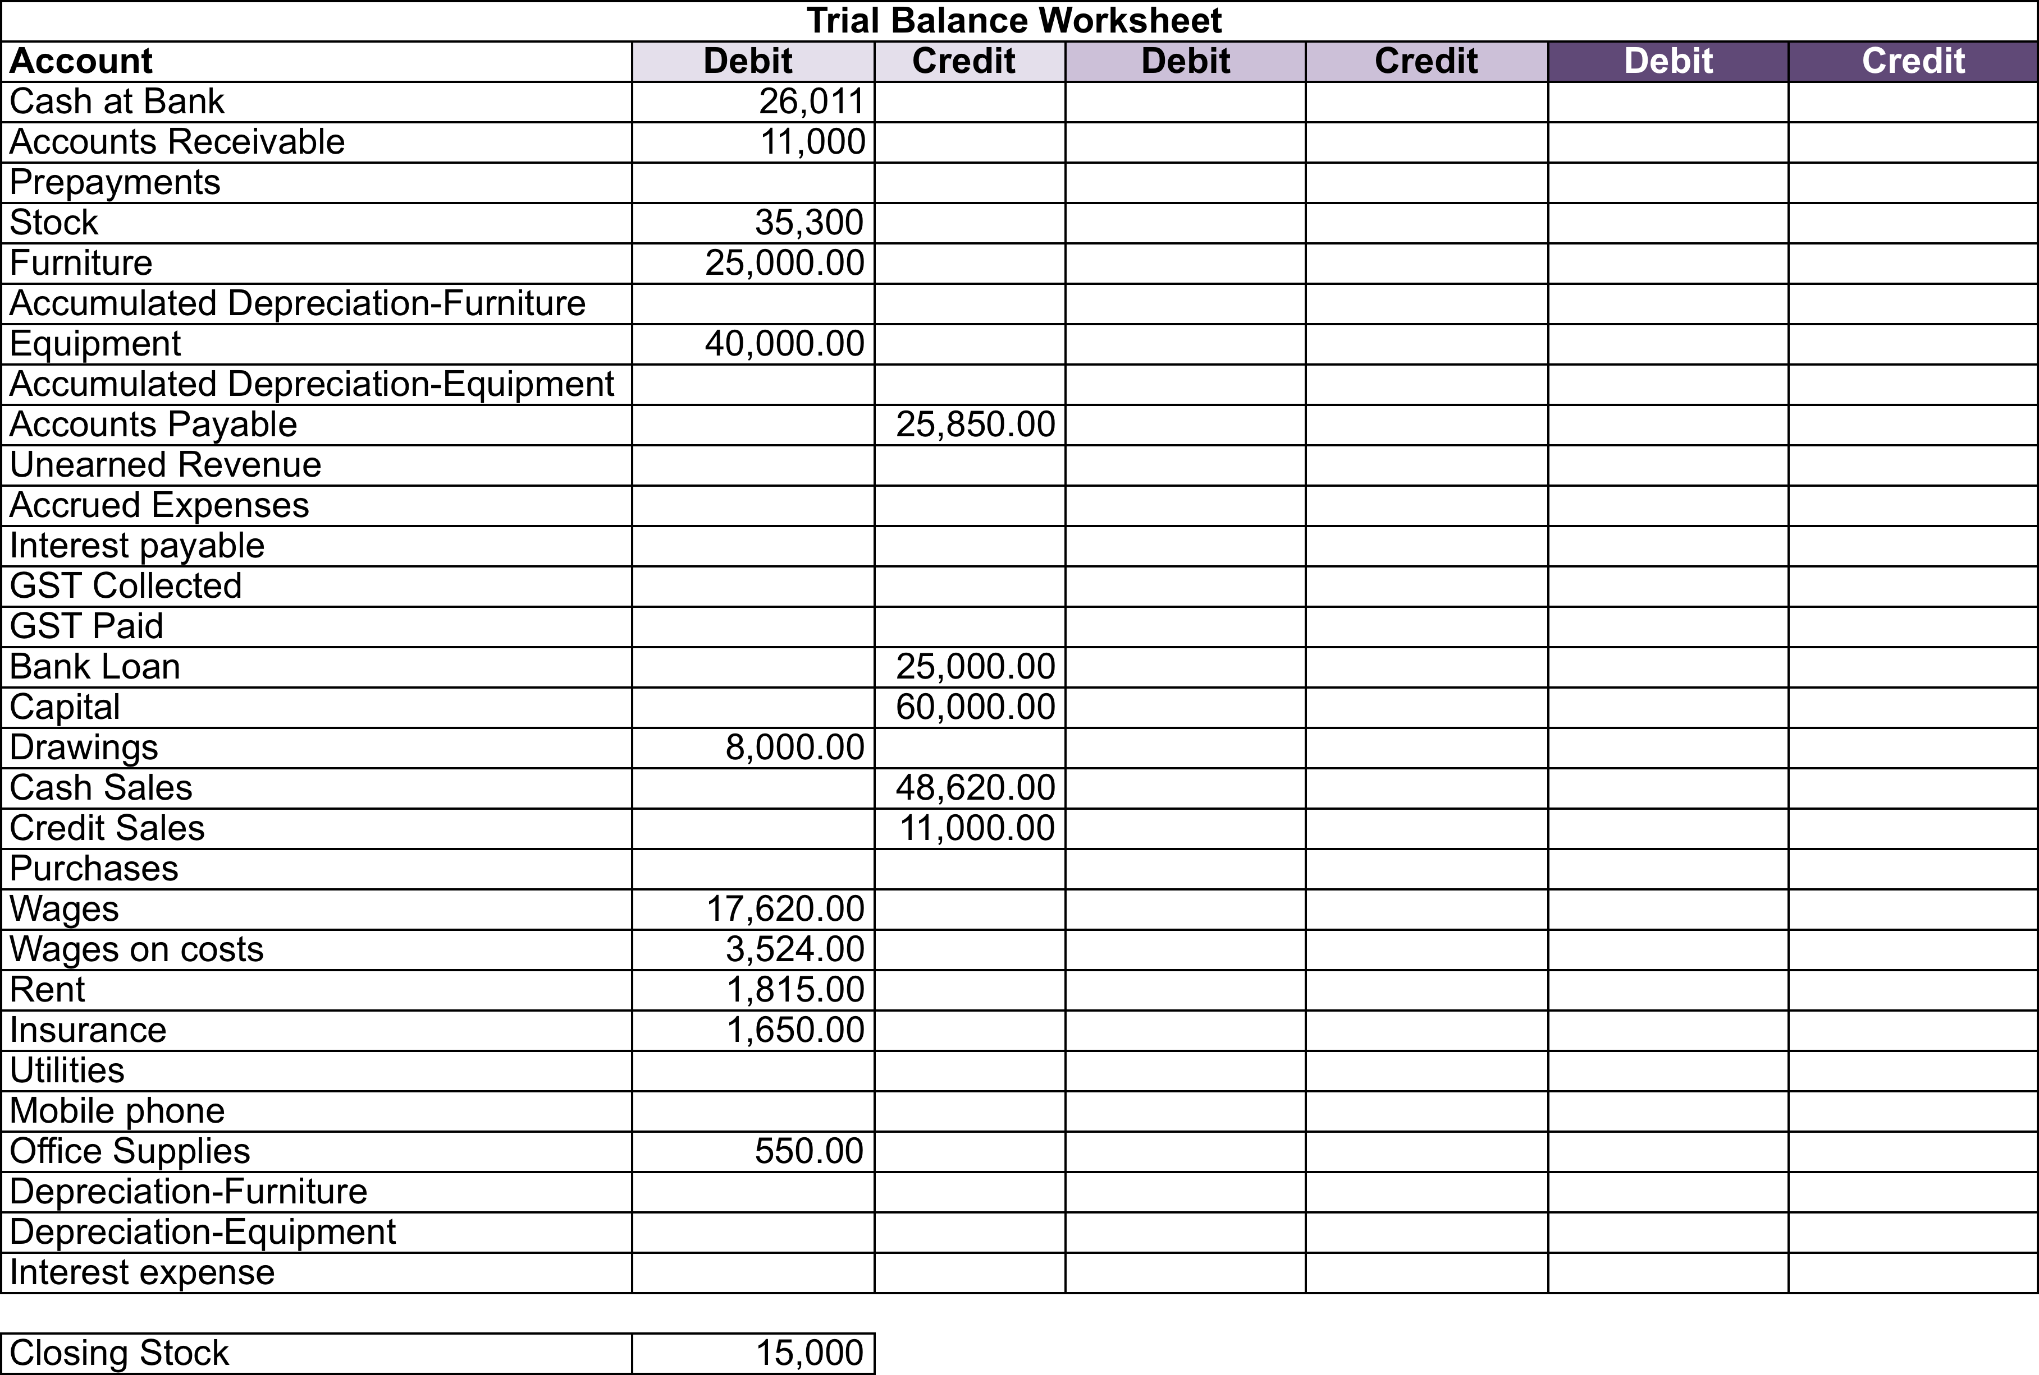
Balancing transactions
The trial balance worksheet
Notes:
Trainers can demonstrate where the draft, adjustments and final entries are entered when a worksheet is used.

Slide 70
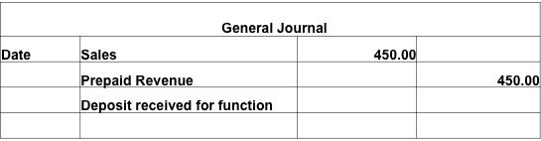
Balancing transactions
Adjusting entries:
Unearned revenue
Notes:
Trainers refer to training manual for more information.

Slide 71
Balancing transactions
Adjusting entries:
Prepayments
General Journal
DATE | Rent expense | 1,000.00
 | Prepaid Rent |  | 1,000.00
 | (1 months Rent)
Notes:
Trainers refer to training manual for more information.

Slide 72
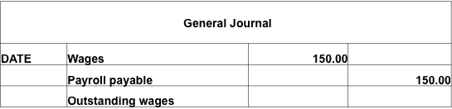
Balancing transactions
Adjusting entries:
Accrued expenses
Notes:
Trainers refer to training manual for more information.

Slide 73
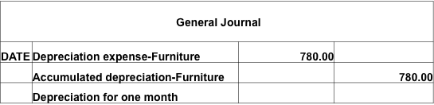
Balancing transactions
Adjusting entries
Depreciation
Notes:
Trainers refer to training manual for more information.

Slide 74

Check balances prepared by others
Checking balances:
Special journals:
Separate recording responsibilities
Review journal balances
Post to the ledger
Notes:
Trainer: the processes that enable the efficient input and processing of transactions also provide an inbuilt check on balances prepared by others as duties are usually separated as required by internal controls. T

Slide 75

Check balances prepared by others
Checking balances:
Subsidiary ledgers:
What is a subsidiary ledger?
Why are they used?
What is a control account?
Common examples
Notes:
Trainees should be aware of subsidiary ledgers used in the tourism and hospitality industry and that the details of transactions are not recorded in control accounts. The reconciliation between the two recording documents provides the checks on balances.

Slide 76
Check balances prepared by others
Checking balances:
Reconciling the subsidiary ledgers:
What is a reconciliation?
Reconciliation report or document
Timing
Investigate and resolve differences
Notes:
Trainers work through the process of a reconciliation. Usually reconciliations are recorded on standard documents and reviewed, provided further checks on balances prepared by others. Each subsidiary ledger is reviewed in the next slides.

Slide 77

Check balances prepared by others
Checking balances:
Accounts receivable subsidiary ledger:
Sales and Cash receipts journal
Monitor debtor accounts
Notes:
Continued from previous slide

Slide 78

Check balances prepared by others
Checking balances:
Accounts payable subsidiary ledger:
Purchases and cash payments journal
Monitor cash flow
Notes:
Continued from previous slide

Slide 79

Check balances prepared by others
Checking balances:
Inventory subsidiary ledger:
Purchases and cash payments journal
Stocktake or stock counts
Independent verification of balances
Notes:
Continued from previous slide

Slide 80

Check balances prepared by others
Checking balances:
Fixed assets register:
Purchases and cash payments journal
Stocktake or stock counts
Independent verification of balances
Notes:
Continued from previous slide

Slide 81

Check balances prepared by others
The bank reconciliation:
General ledger bank account:
Updated from cash journals and general journal
Increases – debit, decreases – credit
The bank statement:
Deposits and withdrawals
CAUTION – debits and credits
Notes:
It is important that trainees understand the definition of cash as encompassing all forms of payment received from customers, guests and other third parties and made to suppliers, staff and other parties. Internal controls safeguarding cash must be strict, especially in the tourism and hospitality industry as there are often large volumes of cash across multiple locations. Trainers may wish to draw upon the experiences of the group for local relevant examples or provide their own.
Trainer: Discuss the detail included in the general ledger bank account and the bank account as well as the source of the information. Reiterate what debit and credit entries represent.

Slide 82
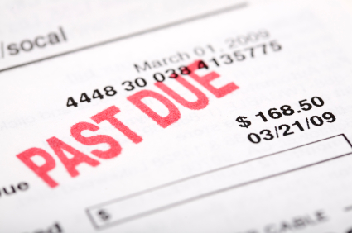
Check balances prepared by others
The bank reconciliation:
Differences:
Timing
Errors
Dishonoured payment
Other
Notes:
Trainer:The bank reconciliation is the means by which the general ledger account balance and the bank account balance are verified. Trainees may be able to draw on their own experiences for recognising some of the differences.

Slide 83
Check balances prepared by others
The Bank reconciliation:
Preparation:
Gather information
Enter balances into the bank reconciliation statement
Check previous outstanding items are recorded
Add or subtract from bank balance items in ledger account
Adjust the ledger account
Check that the bank balance and ledger account agree
Complete the bank reconciliation statement
Notes:
Trainer: refer to the training manual for detail

Slide 84
Check balances prepared by others
 | Bank reconciliation statement as at Day, Month, Year
 | Balance as per bank statement | $ | $
 | Add: Outstanding deposit |  | XX | CR
 | Deposit 1 | XX
 | Deposit 2 | XX | XX
 | Less: Unpresented cheques
 | Cheque 1 | XX
 | Cheque 2 | XX | XX
 | Balance as per cash at bank account |  | XX | DR
Notes:
Trainers can use this diagram to discuss the elements of the bank statement from the notes provided in the training manual. The following slide summarises the key points.

Slide 85

Check balances prepared by others
Produce the bank reconciliation statement:
Key points:
Heading
Reporting period
Debits and credits
Begin with bank statement
End with a total that agrees to the General ledger account
Distribution, review and filing procedures
Notes:
Continued from previous slide. Examples of missing entries can be taken from training manual.

Slide 86
Resolving errors in the financial system
Checklist for resolving errors:
Inputs:
Examples
Processing:
Examples
Outputs:
Examples
Notes:
Trainers: Errors and discrepancies have been discussed throughout the slides so far. This is a review or reminder of what to do when an error is found

Slide 87
Maintaining the financial system
TRANSACTIONS
SOURCE DOCUMENTS
JOURNALS
LEDGERS
TRIAL BALANCE
FINANCIAL REPORTS
Inputs
Processing
Outputs
Notes:
Trainer: The focus for the next series of slides is the outputs phase of the accounting system.

Slide 88

Providing financial information
How is financial information provided?
Reports
Why is financial information needed?
Control
Monitor
Evaluate
Notes:
Trainers focus on the need for management to gather information that allows them to control, monitor and evaluate operations. Operations are considered in terms of two related cycles, the business cycle and the revenue cycle. This is detailed on the next two slides. Reports are discussed in terms of the cycle of operations.

Slide 89
Providing financial information
Hospitality and tourism business cycle
Used to purchase
Supplies, labour & other expenses to produce goods & services
Cash reserves (& credit facilities)
Supplies
Profits
Produces
Sales of goods & services
Accounts receivable or cash
Generates
Notes:
Continued from previous slide

Slide 90
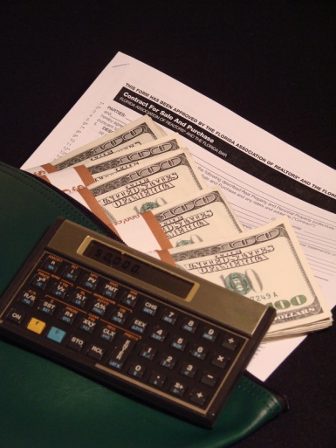
Providing financial information
Sales or revenue cycle:
Daily operating cycle
Weekly operating cycle
Seasonal cycle
Economic cycles
Notes:
Continued from previous slide

Slide 91

Providing financial information
The profit and loss statement:
Definition and purpose
Revenue less Expenses = Net Profit or Loss
Frequency
Format
Department or functional area
Comparative data
Notes:
Trainers: Note that the rest of the slides provide examples of the different reports that are produced in hospitality and tourism establishments. Report formats, frequency and the nature of information is unique to each type of business, the region and management requirements. Therefore trainers must be prepared to source relevant, local examples so trainees are aware of the format used in their local areas.
All report data is sourced from ledger accounts.

Slide 92
Providing financial information
Preparing the profit and loss statement:
Headings
Sales accounts
Cost of sales or
Cost of goods sold:
Gross profit
Other expenses
Your place profile and loss statement for period ending Day, Month, Year
Cash sales |  | 48,620.00
Credit sales |  | 11,000.00
Total sales |  |  | 59,620.00
Less COGS
Opening stock |  | 10,000.00
Purchases |  | 25,300.00
End stock |  | (15,000.00)
Total cost of goods sold |  |  | 20,300.00
Gross profit |  |  | 39,320.00
Operating expenses |  | 17,620.00
Wages |  | 3,524.00
Rent |  | 1,815.00
Insurance |  | 1,650.00
Office supplies |  | 550.00
Total operating expenses |  |  | 25,159.00
Net profit |  |  | 14,161.00
Notes:
Continued from previous slide.

Slide 93
Providing financial information
The Balance sheet:
Definition and purpose
The Accounting equation
Assets – Liabilities = Equity
Frequency and format
Headings
Comparative data
Notes:
Trainers refer to the training manual for details on preparing the balance sheet and are encouraged to use relevant local examples.

Slide 94
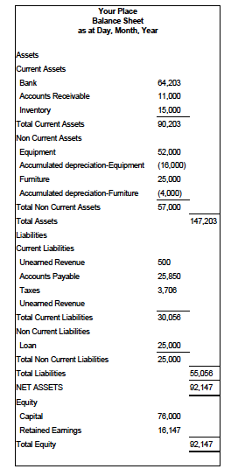
Providing financial information
The Balance sheet:
Assets and liabilities:
Current
Non-current
Equity:
Capital
Retained earnings
Notes:
Continued from previous slide

Slide 95

Providing financial information
The cash flow statement:
Purpose
Frequency
Format
Nature of the financial information:
Cash inflows
Cash outflows
Cash budget
Bank balance
Notes:
Trainers refer to the training manual for details and the following slide for a sample cash flow statement. Trainers are encouraged to use relevant local examples

Slide 96
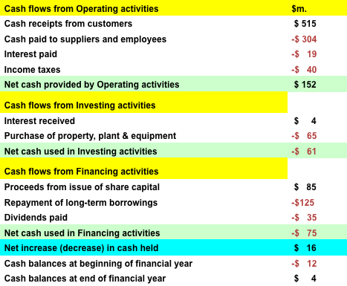
Providing financial information
The cash flow statement
Notes:
Trainers refer to the training manual for details and the following slide for a sample revenue report. Trainers are encouraged to use relevant local examples

Slide 97
Providing financial information
Expense reports:
Controllable and non-controllable costs
Direct and indirect costs
Fixed and variable costs
Direct and controllable
Notes:
Trainers refer to the training manual for details and local examples

Slide 98

Providing financial information
Payroll cost report:
Purpose
Format and frequency
Nature of the financial information:
Hours worked
Rates of pay
Total daily, month-to-date
Budget
Ratios
Notes:
Trainers refer to the training manual for details and provide local examples.

Slide 99

Providing financial information
Other key expense reports:
Food and beverage costs
Total room servicing or housekeeping costs
Nature of the financial information:
Details of daily costs (quantities and amounts)
Total daily, month-to-date
Budget
Ratios
Notes:
Trainers refer to the training manual for details and the following slide for a sample revenue report. Trainers are encouraged to use relevant local examples

Slide 100
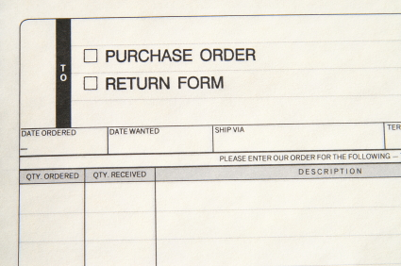
Providing financial information
Purchase order summary:
Purpose
Format and frequency
Financial information:
Quantities ordered
Total costs
Expected delivery
Recording as an expense
Notes:
Trainers refer to the training manual for details and provide local examples.

Slide 101

Providing financial information
The revenue report:
Purpose
Frequency
Format
Nature of the financial information:
Sales
Budget or forecast
Prior periods
Ratios
Notes:
Trainers refer to the training manual for details and the following slide for a sample revenue report. Trainers are encouraged to use relevant local examples

Slide 102
Providing financial information
The revenue report (an example)
 | Actual revenue (today) | Budget revenue (today) | Last year (same day) | Ratio
Total rooms available
Number of rooms sold in total
Room sold – Leisure
Room sold – Walk ins
Average room rate – Leisure
Average room rate – Walk ins
Arrivals
Departures
Notes:
Continued from previous slide

Slide 103
Providing financial information
Other schedules:
Food and beverage menu schedule:
All menu items
Profitability and popularity
Standard food and beverage cost percentages for each menu item
Notes:
Trainers refer to the training manual for details and the following slide for a sample revenue report. Trainers are encouraged to use relevant local examples

Slide 104

Providing financial information
Cash and accounts receivable:
Daily takings report:
High volume of cash transactions
Completed at point of sale terminal
Entered into cash receipts journal
Notes:
Trainers refer to the training manual for details and provide local examples.

Slide 105
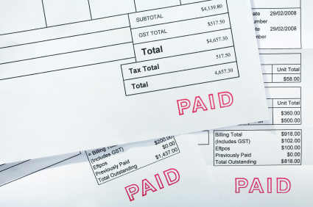
Providing financial information
Cash and accounts receivable:
Daily cash received report:
Amounts received from debtors
Accounts receivable subsidiary ledger updated
Cash receipts journal updated
BEWARE separation of duties!
Notes:
Trainers refer to the training manual for details and provide local examples.

Slide 106
Providing financial information
Cash and accounts receivable
Accounts receivable ageing schedule
Number of days due | Current | Less than 30 | 30 – 60 | 60 – 90 | 90+ | Total
Accounts receivable | 4,900 | 490 | 1,400 | 140 | 70 | 7,000
Percentage | 70% | 7% | 20% | 2% | 1%
Notes:
Trainers refer to the training manual for details and the following slide for a sample revenue report. Trainers are encouraged to use relevant local examples

Slide 107

Providing financial information
Distribution of financial statements:
Confidentiality
Adhere to reporting deadlines
Schedule to follow
Secure passwords
Notes:
Trainers guide trainees through the steps to distribute financial statements which are mostly administrative tasks. At all times, financial statements should be treated securely and confidentiality maintained.

